Slide 1
A Study and Analysis of Air Quality Index In LockDown
– B22SSR03

Slide 2




The Team!
Dr Sreeja S R Mentor
Chetan
S20190010129
chetanreddy.o19@iiits.in
Abhijnya
S20190010172
abhijnya.t19@iiits.in
Snehith
S20190010085
snehith.k19@iiits.in

Slide 3
Agenda
Introduction & Motivation
Literature Review
Work Done&
Plan of Action
1
3
5
2
4
6
Problem Statement
Dataset
Description
References

Slide 4
Introduction & Motivation

Slide 5
The nationwide Janta Curfew on March 22, 2020 and lockdown since March 24, 2020, have resulted in significant improvement in air quality in the country, as revealed by data analysis and comparison of data for time before enforcement of restrictions.
— Central Pollution Control Board (Ministry of Environment, Forest and Climate Change) Govt. of India, Delhi [1]

Slide 6
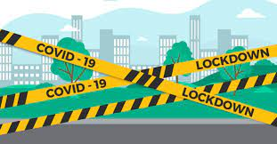
Many countries put temporary closures of their industries and jobs on the agenda and on the other hand, restrictions within cities were seriously pursued in most countries and the same goes for ours as well.
These actions include restrictions on inter-city
and intra-city traffic, closing businesses, closure
of schools and small communities, suspension
of tourist visas and so on.

Slide 7
Problem Statement
To analyze and statistically conclude whether air quality is improved significantly during the lockdown or not and provide concluding evidences as an interactive web application.

Slide 8
Literature Review

Slide 9
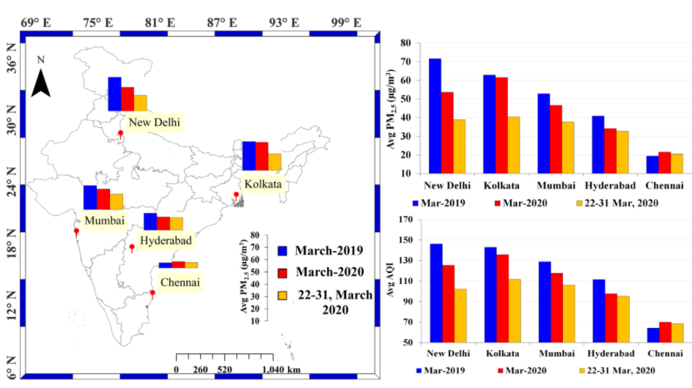
Singh, R.P., Chauhan, A. Impact of lockdown on air quality in India during COVID-19 pandemic.
–Air Qual Atmos Health 13, 921–928 (2020).[3]
In this paper, they present an analysis of air quality (particulate matter-PM2.5, Air Quality Index, and tropospheric NO2) over India using ground and satellite observations.
The results show a pronounced decline in air pollutants during lockdown especially in Delhi and Kolkata; these two cities are known to be highly polluted cities in India and in the world.

Slide 10
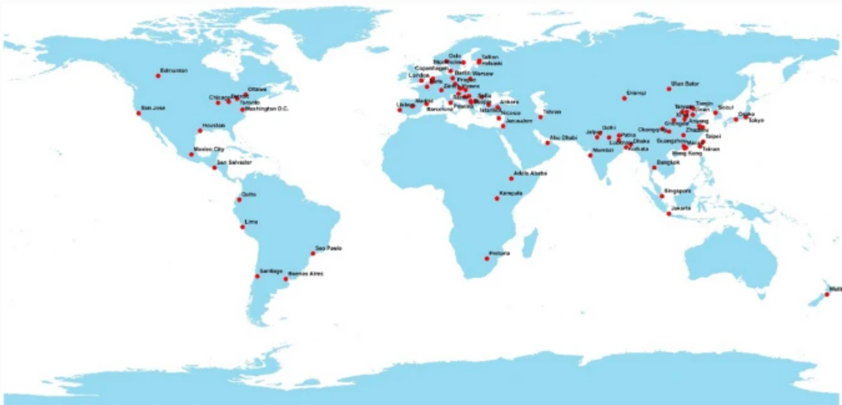
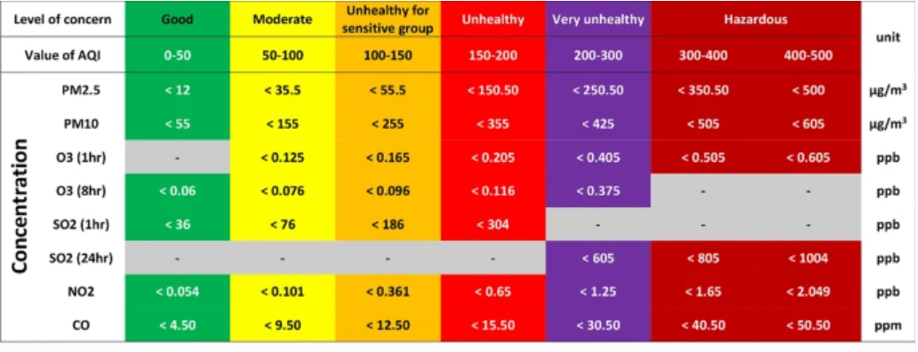
Sarmadi, M., Rahimi, S., Rezaei, M. et al. Air quality index variation before and after the onset of COVID-19 pandemic: a comprehensive study on 87 capital, industrial and polluted cities of the world.
–Environ Sci Eur 33, 134 (2021).[4]
This is an ecological and city-level study based which was designed to examine changes in air quality index (AQI) of various pollutants during the first 121 days of 2020 and comparison with past and next year.
One of the first papers to be published regarding air quality data analysis.
One limitation is the location of air quality monitoring stations, which was not considered in this study due to lack of access.

Slide 11
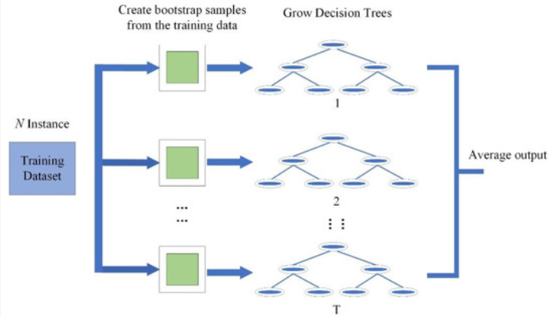
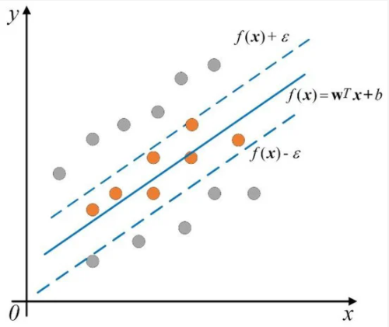
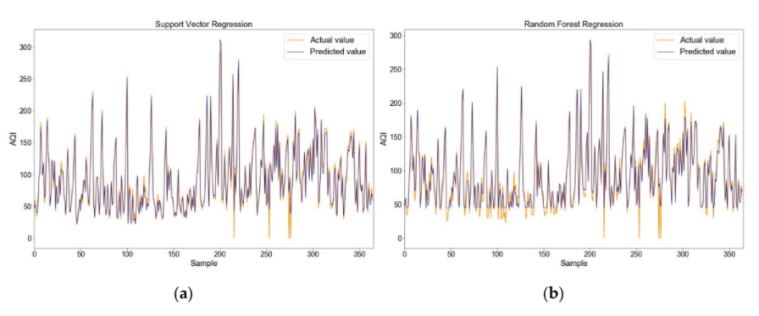
Liu H, Li Q, Yu D, Gu Y. Air Quality Index and Air Pollutant Concentration Prediction Based on Machine Learning Algorithms.
–Applied Sciences. 2019; 9(19):4069.[5]
Used Support Vector Regression (SVR) and Random Forest Regression (RFR) to build regression models for predicting the Air Quality Index (AQI) in Beijing and the nitrogen oxides (NOX) concentration in an Italian city.
Concluded that both the SVR-based model and the RFR-based model can achieve good results, but the RFR model performs better in experiments.

Slide 12
Dataset
Description

Slide 13

Data Collection
For this project we are using data from Central Pollution Control Board’s (CPCB)
AQI Bulletin data summary.

Slide 14
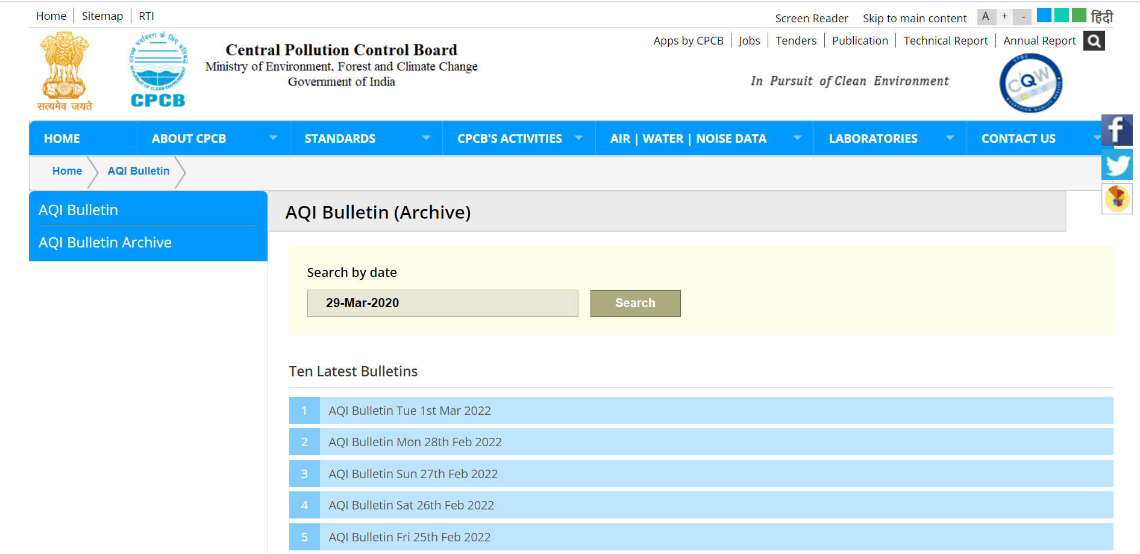
[6]

Slide 15
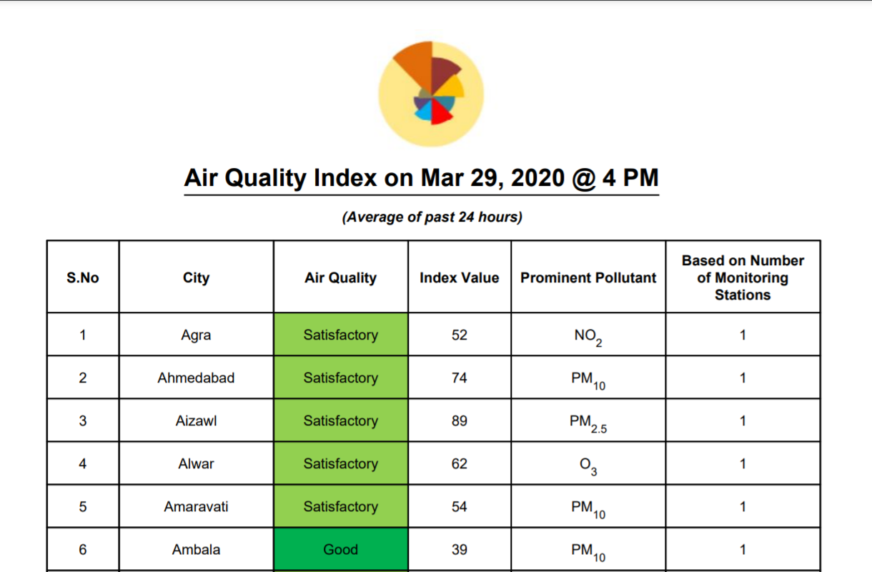
[7]

Slide 16
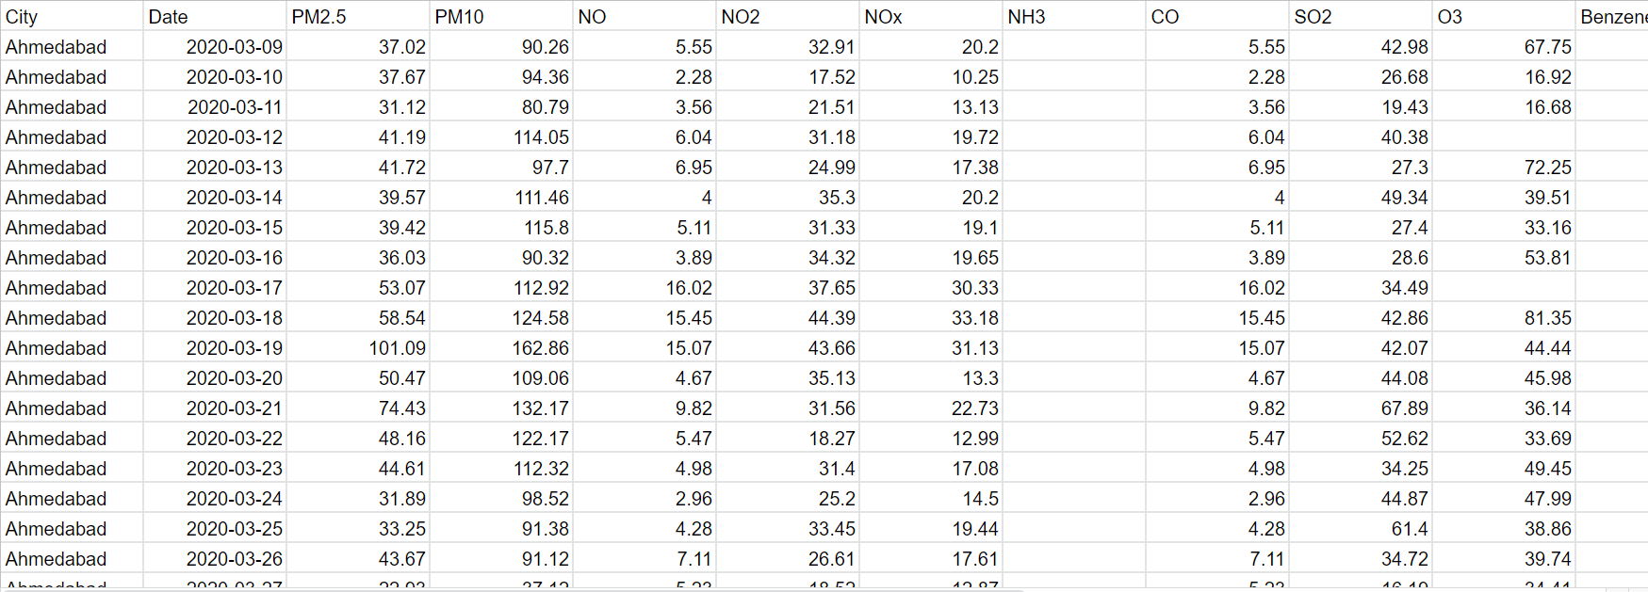
Sample Data
[11]

Slide 17
Work Done &
Plan of Action

Slide 18
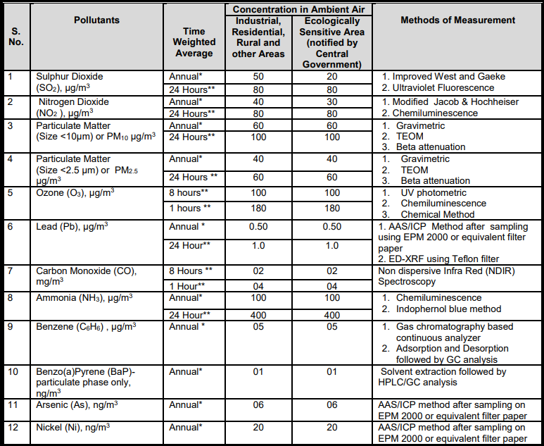
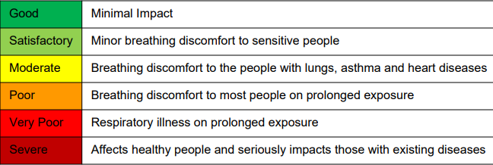
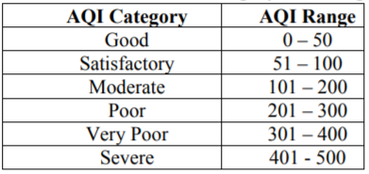
An in depth study on sources and effect of each pollutant as mentioned by CPCB(Central Pollution Control Board)
We have done a good literature survey for the first presentation and understood the required parameters in depth.
We have gone through different types of AQI’s and explored how it differs for countries as well.
A detailed summary on our work can be found in References.[13]
[12]

Slide 19
Timeline For This Semester
End Review
Data preprocessing, feature selection and classification and start developing the web application.
03
Searching Problem Statement
01
02
Mid Review
We have done a good literature survey for the mid review and understood the required parameters and got a hold of data-set required for analysis.

Slide 20
References
Central Pollution Control Board (Ministry of Environment, Forest and Climate Change) Govt. of India, Delhi, https://cpcb.nic.in/air/NCR/jantacurfew.pdf.
Central Pollution Control Board (Ministry of Environment, Forest and Climate Change) Govt. of India, Delhi, https://cpcb.nic.in/openpdffile.php?id=TGF0ZXN0RmlsZS9fMTU4ODE1NjM0OF9tZWRpYXBob3RvMjEyNDEucGRm.
Singh, R.P., Chauhan, A. Impact of lockdown on air quality in India during COVID-19 pandemic. Air Qual Atmos Health 13, 921–928 (2020). https://doi.org/10.1007/s11869-020-00863-1.
Sarmadi, M., Rahimi, S., Rezaei, M. et al. Air quality index variation before and after the onset of COVID-19 pandemic: a comprehensive study on 87 capital, industrial and polluted cities of the world. Environ Sci Eur 33, 134 (2021). https://doi.org/10.1186/s12302-021-00575-y.
Liu H, Li Q, Yu D, Gu Y. Air Quality Index and Air Pollutant Concentration Prediction Based on Machine Learning Algorithms. Applied Sciences. 2019; 9(19):4069. https://doi.org/10.3390/app9194069.

Slide 21
References
Central Pollution Control Board (Ministry of Environment, Forest and Climate Change) Govt. of India, Delhi, https://cpcb.nic.in/AQI_Bulletin.php
Central Pollution Control Board (Ministry of Environment, Forest and Climate Change) Govt. of India, Delhi, https://cpcb.nic.in/upload/Downloads/AQI_Bulletin_20200329.pdf.
Central Pollution Control Board (Ministry of Environment, Forest and Climate Change) Govt. of India, Delhi, https://app.cpcbccr.com/ccr_docs/FINAL-REPORT_AQI_.pdf.
Central Pollution Control Board (Ministry of Environment, Forest and Climate Change) Govt. of India, Delhi, https://cpcb.nic.in/upload/NAAQS_2019.pdf.
Central Pollution Control Board (Ministry of Environment, Forest and Climate Change) Govt. of India, Delhi, https://www.gov.uk/government/publications/ammonia-properties-incident-management-and-toxicology.
Rohanrao, Air Quality Data in India (2015 - 2020), version-12,, Kaggle, https://www.kaggle.com/rohanrao/air-quality-data-in-india/version/12?select=city_day.csv.
Central Pollution Control Board (Ministry of Environment, Forest and Climate Change) Govt. of India, Delhi, https://app.cpcbccr.com/ccr_docs/FINAL-REPORT_AQI_.pdf.
https://docs.google.com/presentation/d/1wuQWl8oA2xo_k7bolAAw87UkTyr9b9wh_CnVo4ksKd8/edit?usp=sharing

Slide 22

Thanks!
Any questions?

